Slide 2
Course Content:
A quick review of important mathematical concepts - Vector space, linear dependence and independence of vectors, matrix inverse, pseudo inverse, matrix diagonalization, singular valued decomposition. Convex/non‐convex functions, constrained/unconstrained optimization, gradient and steepest descent methods, Linear Programming Problem (LPP), Quadratic Programming Problem (QPP).
Regression models: - Multivariate Gaussian Distribution, Maximum Likelihood Estimate, Regression models assumptions, Least Square linear regression models, Basis functions for nonlinear least square regression models, Empirical Risk Minimization, Bias-variance Trade-off, Regularization. Kernel functions in Machine Learning models, Support Vector Regression models and its variants, Extreme Learning Machine.
Classification models: - Bayesian Classifier, Gaussian models, Naïve‐Bayes Classifier, Linear Discriminate Analysis, Kernel Discriminant Analysis, Logistic Regression, Support Vector Machine for binary classification and its variants, Multiclass Support Vector Machine.
Unsupervised Learning, Principal Component Analysis, K-nearest neighbor algorithms. Clustering methods.

Slide 3
Suggested Books:
Deisenroth, Marc Peter, A. Aldo Faisal, and Cheng Soon Ong. Mathematics for
machine learning. Cambridge University Press, 2020.
Chandra, Suresh, Jayadeva, and Aparna Mehra. Numerical optimization with
applications. Alpha Science International, 2009.
Bishop, Christopher M. Pattern recognition and Machine learning 128.9 (2008).
Friedman, Jerome, Trevor Hastie, and Robert Tibshirani. The elements of statistical
learning. Vol. 1. No. 10. New York: Springer series in statistics, 2001.
Deng, Naiyang, Yingjie Tian, and Chunhua Zhang. Support vector machines:
optimization based theory, algorithms, and extensions. CRC press, 2012.
Duda, Richard O., and Peter E. Hart. Pattern classification. John Wiley & Sons, 2006.
Zaki, Mohammed J., and Wagner Meira Jr. Data Mining and Machine Learning: Fundamental Concepts and Algorithms. Cambridge University Press, 2020.

Slide 4
Evaluation method: Assignments, One mid semester Exam, Presentation, Mini Project, One end semester Exam.

Slide 7
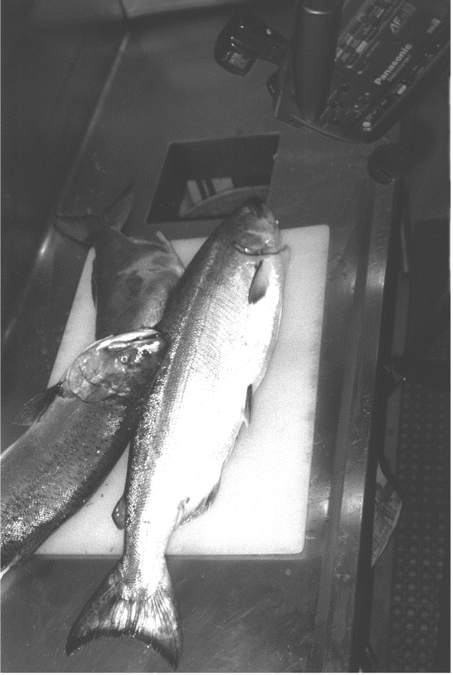
Classification Problem
Length ( cm ) | Height (cm) | Number of fins | Weight (Kg) | Color | Fish type
17.8 | 22.9 | 8 | 5.1` | Orange | Salman
14.8 | 20.5 | 7 | 4.9 | Black | Sea bass
16. 34 | 12.76 | 6 | 6.6 | Grey | Salman
10. 34 | 8.76 | 3 | 3.8 | Grey | Salman
--- | ----- | ---- | ------ | ------ | --------
11 .30 | 17.76 | 6 | 9.8 | Orange | Sea bass

Slide 9
Classification Problem
Length ( cm ) | Height (cm) | Number of fins | Weight (Kg) | Color | Fish type
17.8 | 22.9 | 8 | 5.1 | Orange | Salman
14.8 | 20.5 | 7 | 4.9 | Black | Sea bass
16. 34 | 12.76 | 6 | 6.6 | Grey | Salman
10. 34 | 8.76 | 3 | 3.8 | Grey | Salman
--- | ----- | ---- | ------ | ------ | --------
11 .30 | 17.76 | 6 | 9.8 | Orange | Sea bass
8 .25 | 11 .80 | 4 | 4.8 | Grey | Surmai
7 .30 | 8.76 | 5 | 9. 6 | Blue | Surmai
1
Given a training set { (X_{i} , Y_{i}) : X_{i} ϵ R ^{n} , Y_{i} ϵ {1,2,…,k} , i = 1,2,.., l }, find a function f which can efficiently predict the label Y for an unseen X ϵ R^{n .}
1. Duda and Hart, Pattern Classification , John Wiley and Sons, 2006 .

Slide 11
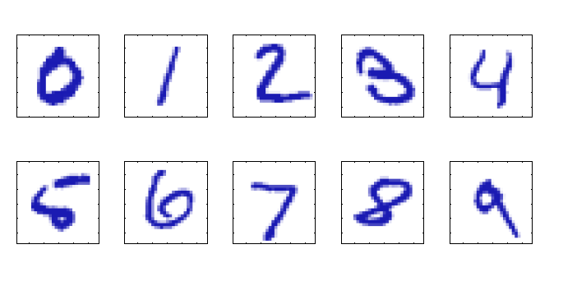

Slide 12
Gender | Education | Seniority | Age | Work class | Income
Male | 3 | 3 | 34 | Private | 78 K
Female | 2 | 2 | 65 | Govt. | 89 K
Male | 1 | 4 | 25 | Govt. | 28 K
Female | 5 | 6 | 39 | Private | 112 K
--- | ----- | --- | ------ | ------ | --------
Female | 2 | 8 | 45 | Govt. | 84 K
Female | 4 | 9 | 40 | Private | 76 K
Male | 2 | 0 | 42 | Govt. | 81 K

